Slide 1


Unit-4
Machine Learning Techniques [KCS-055]
Module-4
ARTIFICIAL NEURAL NETWORKS

Slide 2
Syllabus
– Perceptron’s, Multilayer perceptron, Gradient descent and the Delta rule, Multilayer networks, Derivation of Back propagation Algorithm, Generalization, Unsupervised Learning – SOM Algorithm and its variant; DEEP LEARNING - Introduction, concept of convolutional neural network , Types of layers – (Convolutional Layers , Activation function , pooling , fully connected) , Concept of Convolution (1D and 2D) layers, Training of network, Case study of CNN for eg on Diabetic Retinopathy, Building a smart speaker, Self-deriving car etc.

Slide 3
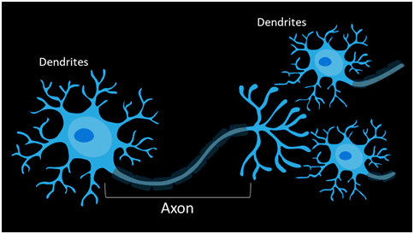
Motivation Behind ANN:
Dendrite receives signals from other neurons.
Cell body sums the incoming signals to generate input.
When the sum reaches a threshold value, neuron fires and the signal travels down the axon to the other neurons.

Slide 4
What is Artificial Neural Network?
A Neural Network is a system designed to operate like a human brain. Human information processing takes place through the interaction of many billions of neurons connected to each other sending signals to other neurons.
Similarly, a Neural Network is a network of artificial neurons, as found in human brains, for solving artificial intelligence problems such as image identification. They may be a physical device or mathematical constructs.
In other words, Artificial Neural Network is a parallel computational system consisting of many simple processing elements connected to perform a particular task.

Slide 5
Artificial Neural Network : Definition
Artificial Neural Networks or ANN is an information processing paradigm that is inspired by the way the biological nervous system such as brain process information. It is composed of large number of highly interconnected processing elements(neurons) working in unison to solve a specific problem.

Slide 6
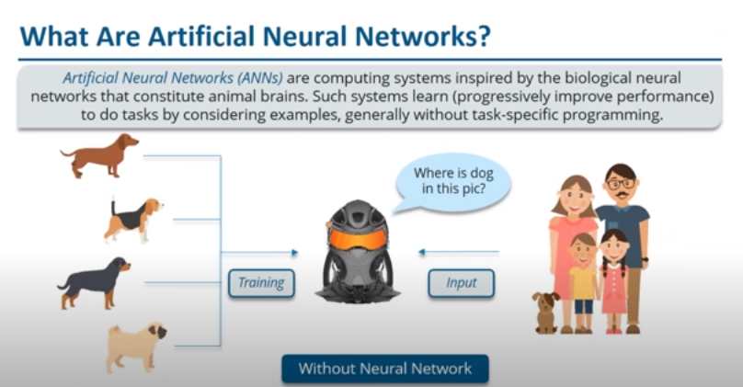
Notes:
Without neural network, when m/c will be given a set of data other than its training i.e. here m/c is trained with 4 types of dogs only, and let say you have provided a different dog.In this case m/c will be confused…

Slide 7
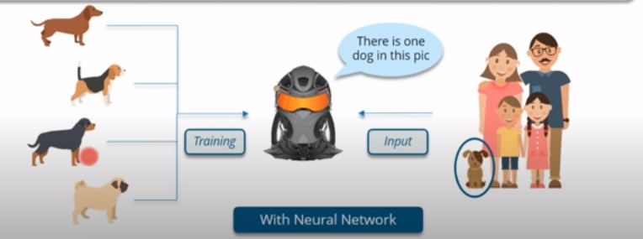
Notes:
But using neural n/w, m/c will be able to classify this dog.

Slide 8
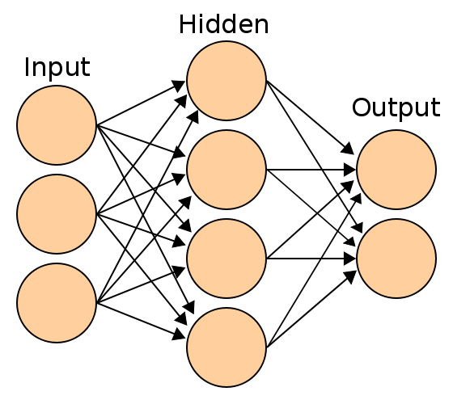
Artificial Neural Networks Architecture

Slide 9
ANN Representation
In a neural network, there are three essential layers –
Input Layers
Hidden Layers
Output Layers

Slide 10
The input layer is the first layer of an ANN that receives the input information in the form of various texts, numbers, audio files, image pixels, etc.
In the middle of the ANN model are the hidden layers. There can be a single hidden layer, as in the case of a perceptron or multiple hidden layers. These hidden layers perform various types of mathematical computation on the input data and recognize the patterns that are part of.
In the output layer, we obtain the result that we obtain through rigorous computations performed by the middle layer.

Slide 11
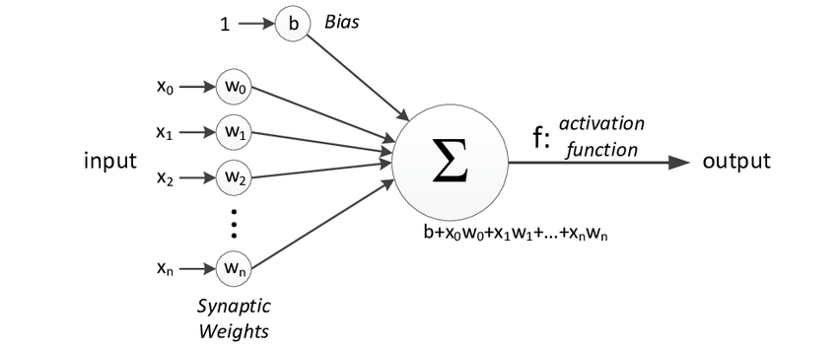
Perceptron:
The following diagram represents the general model of ANN which is inspired
by a biological neuron.
It is also called Perceptron.
A single layer neural network is called a Perceptron.
It gives a single output.

Slide 12
Explanation of Perceptron
In the above figure, for one single observation, x0, x1, x2, x3...x(n) represents various inputs(independent variables) to the network. Each of these inputs is multiplied by a connection weight or synapse. The weights are represented as w0, w1, w2, w3….w(n) . Weight shows the strength of a particular node.
b is a bias value. A bias value allows you to shift the activation function up or down.
In the simplest case, these products are summed, fed to a transfer function (activation function) to generate a result, and this result is sent as output.
Mathematically, x1.w1 + x2.w2 + x3.w3 ...... xn.wn = ∑ xi.wi
Now activation function is applied 𝜙(∑ xi.wi)

Slide 13
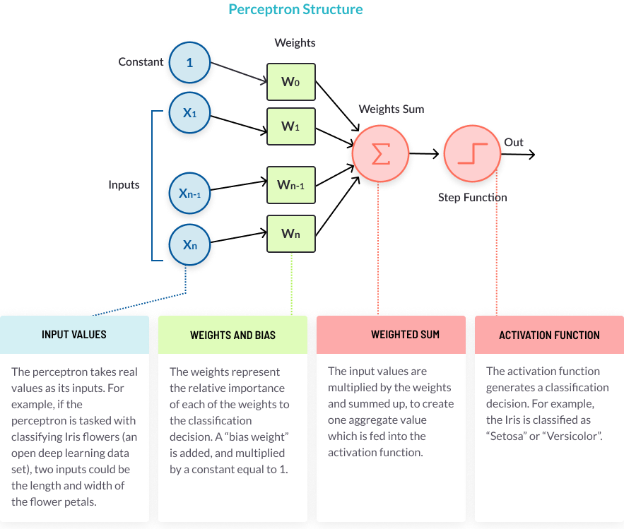
Structure of a Perceptron

Slide 14
The Perceptron Learning Process
A perceptron follows these steps:-
1. Takes the inputs, multiplies them by their weights, and computes their sum
The weights allow the perceptron to evaluate the relative importance of each of the outputs. Neural network algorithms learn by discovering better and better weights that result in a more accurate prediction. There are several algorithms used to fine tune the weights, the most common is called backpropagation.

Slide 15
2. Adds a bias factor, the number 1 multiplied by a weight Why It’s Important This is a technical step that makes it possible to move the activation function curve up and down, or left and right on the number graph. It makes it possible to fine-tune the numeric output of the perceptron. For more details see our guide on neural network bias.

Slide 16
3. Feeds the sum through the activation function Why It’s Important The activation function maps the input values to the required output values. For example, input values could be between 1 and 100, and outputs can be 0 or 1. The activation function also helps the perceptron to learn, when it is part of a multilayer perceptron (MLP). Certain properties of the activation function, especially its non-linear nature, make it possible to train complex neural networks. For more details see our guide on activation functions.

Slide 17
4. The result is the perceptron output The perceptron output is a classification decision. In a multilayer perceptron, the output of one layer’s perceptrons is the input of the next layer. The output of the final perceptrons, in the “output layer”, is the final prediction of the perceptron learning model.

Slide 18
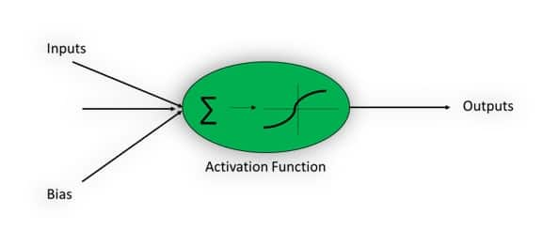
Activation Function:
The Activation function is important for an ANN to learn and make sense of something really complicated.
Their main purpose is to convert an input signal of a node in an ANN to an output signal. This output signal is used as input to the next layer in the stack.

Slide 19
Why Activation Function?
Activation function decides whether a neuron should be activated or not by calculating the weighted sum and further adding bias to it. The motive is to introduce non-linearity into the output of a neuron.
Activation Function helps to solve the complex non-linear model. Without activation function, output signal will just be a linear function and your neural network will not be able to learn complex data such as audio, image, speech, etc.
Some commonly used activation functions are:
Sigmoid or Logistic
Tanh — Hyperbolic tangent
ReLu -Rectified linear units

Slide 20
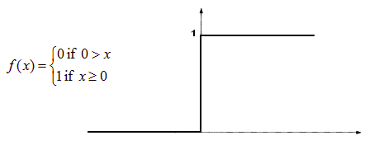
Types of Activation Functions:
Threshold Activation Function — (Binary step function) A Binary step function is a threshold-based activation function. If the input value is above or below a certain threshold, the neuron is activated and sends exactly the same signal to the next layer.
A Binary step function

Slide 21
Activation function A = “activated” if Y > threshold else not or A=1 if y>threshold 0 otherwise.
The problem with this function is for creating a binary classifier ( 1 or 0), but if you want multiple such neurons to be connected to bring in more classes, Class1, Class2, Class3, etc. In this case, all neurons will give 1, so we cannot decide.

Slide 22
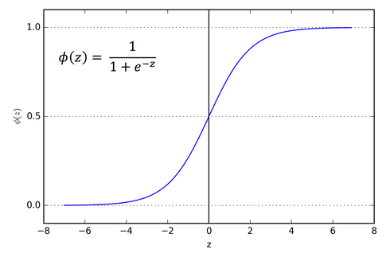
Types of Activation Functions:
Sigmoid Activation Function — (Logistic function) A Sigmoid function is a mathematical function having a characteristic “S”-shaped curve or sigmoid curve which ranges between 0 and 1, therefore it is used for models where we need to predict the probability as an output.
Sigmoid curve

Slide 23
Types of Activation Functions:
Sigmoid Activation Function can be represented as: f(x) = 1 / 1 + exp(-x)
The Sigmoid function is differentiable, means we can find the slope of the curve at any 2 points.
The drawback of the Sigmoid activation function is that it can cause the neural network to get stuck at training time if strong negative input is provided.

Slide 24
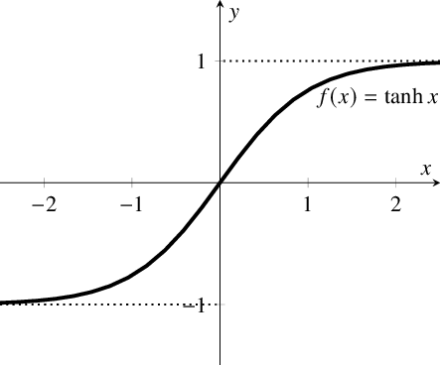
Types of Activation Functions:
Hyperbolic Tangent Function — (tanh) It is similar to Sigmoid but better in performance. It is nonlinear in nature, so great we can stack layers. The function ranges between (-1,1).
Hyperbolic tangent function

Slide 25
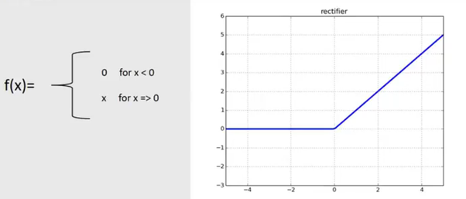
Types of Activation Functions:
Rectified Linear Units — (ReLu) ReLu is the most used activation function in CNN and ANN which ranges from zero to infinity.[0,∞)
ReLu

Slide 26
Types of Activation Functions:
It gives an output ‘x’ if x is positive and 0 otherwise. It looks like having the same problem of linear function as it is linear in the positive axis. Relu is non-linear in nature and a combination of ReLu is also non-linear. In fact, it is a good approximator and any function can be approximated with a combination of Relu.
ReLu is 6 times improved over hyperbolic tangent function.
It should only be applied to hidden layers of a neural network. So, for the output layer use softmax function for classification problem and for regression problem use a Linear function.

Slide 27
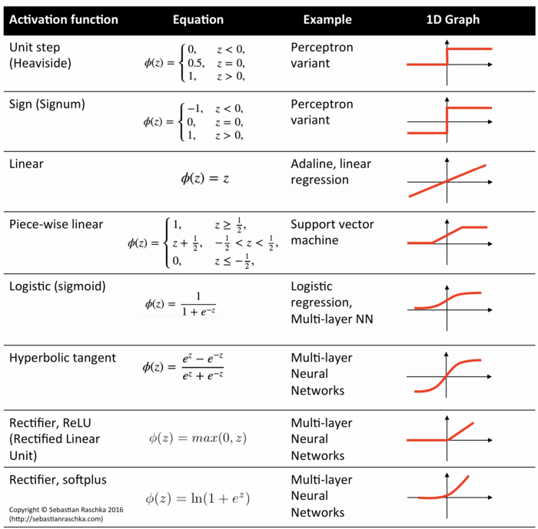

Slide 28
Types of Artificial Neural Networks
Neural networks consist of input, output layers hidden layers. Information flows in neural network happens in two ways-
Feedforward Networks
Feedback Networks

Slide 29
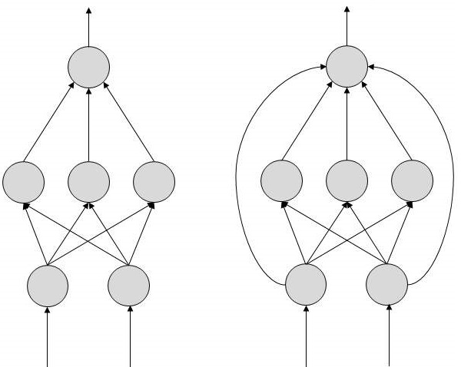
FeedForward ANN
In this ANN, the information flow is unidirectional.
A unit sends information to other unit from which it does not receive any information.
There are no feedback loops. They are used in pattern generation/recognition/classification.
They have fixed inputs and outputs.

Slide 30
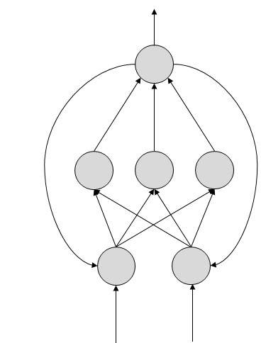
FeedBack ANN
Here, feedback loops are allowed. They are used in content addressable memories.

Slide 31
Multi-Layer Perceptron:
It is a type of feed-forward network.
This propagation uses backpropagation.
However, multilayer perceptron uses the backpropagation algorithm that can successfully classify the XOR data.
A multilayer perceptron (MLP) has the same structure as that of the single layer perceptron with one or more hidden layers.
It uses a non-linear activation function and utilizes backpropagation for training. For example, speech recognition and machine translation.

Slide 32
A multilayer perceptron (MLP) is a perceptron that teams up with additional perceptrons, stacked in several layers, to solve complex problems.
The diagram below shows an MLP with three layers. Each perceptron in the first layer on the left (the input layer), sends outputs to all the perceptrons in the second layer (the hidden layer), and all perceptrons in the second layer send outputs to the final layer on the right (the output layer).

Slide 33
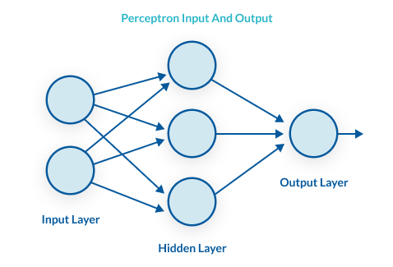

Slide 34
For each signal, the perceptron uses different weights. In the diagram above, every line going from a perceptron in one layer to the next layer represents a different output.
Each layer can have a large number of perceptrons, and there can be multiple layers, so the multilayer perceptron can quickly become a very complex system.

Slide 35
Back Propagation Algorithm
Backpropagation is a supervised learning algorithm, for training Multi-layer Perceptrons (Artificial Neural Networks).
It is the training or learning algorithm. It learns by example. If you submit to the algorithm the example of what you want the network to do, it changes the network’s weights so that it can produce desired output for a particular input on finishing the training.
Back Propagation networks are ideal for simple Pattern Recognition and Mapping Tasks.

Slide 36
What is Backpropagation?
The Backpropagation algorithm looks for the minimum value of the error function in weight space using a technique called the delta rule or gradient descent.
The weights that minimize the error function is then considered to be a solution to the learning problem.

Slide 37
Why We Need Backpropagation?
While designing a Neural Network, in the beginning, we initialize weights with some random values or any variable for that fact.
Now obviously, we are not superhuman. So, it’s not necessary that whatever weight values we have selected will be correct, or it fits our model the best.
Okay, fine, we have selected some weight values in the beginning, but our model output is way different than our actual output i.e. the error value is huge.
Now, how will you reduce the error?
Basically, what we need to do, we need to somehow explain the model to change the parameters (weights), such that error becomes minimum.

Slide 38
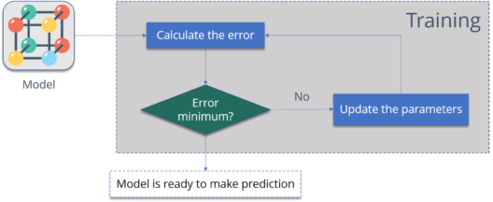
Why We Need Backpropagation?
One way to train our model is called as Backpropagation. Consider the diagram below:

Slide 39
Why We Need Backpropagation?
Calculate the error – How far is your model output from the actual output.
Minimum Error – Check whether the error is minimized or not.
Update the parameters – If the error is huge then, update the parameters (weights and biases). After that again check the error. Repeat the process until the error becomes minimum.
Model is ready to make a prediction – Once the error becomes minimum, you can feed some inputs to your model and it will produce the output.

Slide 40
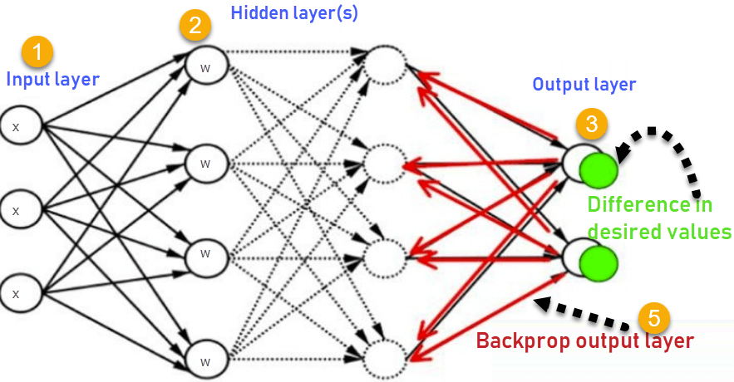
How Backpropagation Works: Simple Algorithm
Consider the below Neural Network:

Slide 41
How Backpropagation Works?
Inputs X, arrive through the preconnected path
Input is modeled using real weights W. The weights are usually randomly selected.
Calculate the output for every neuron from the input layer, to the hidden layers, to the output layer.
Calculate the error in the outputs
Error_{B}= Actual Output – Desired Output
Travel back from the output layer to the hidden layer to adjust the weights such that the error is decreased.
Keep repeating the process until the desired output is achieved

Slide 42
Why We Need Backpropagation?
Most prominent advantages of Backpropagation are:
Backpropagation is fast, simple and easy to program
It has no parameters to tune apart from the numbers of input
It is a flexible method as it does not require prior knowledge about the network
It is a standard method that generally works well
It does not need any special mention of the features of the function to be learned.

Slide 43
Types of Backpropagation Networks
Two Types of Backpropagation Networks are:
Static Back-propagation
Recurrent Backpropagation

Slide 44
1. Static back-propagation:
It is one kind of backpropagation network which produces a mapping of a static input for static output. It is useful to solve static classification issues like optical character recognition.
2. Recurrent Backpropagation:
Recurrent backpropagation is fed forward until a fixed value is achieved. After that, the error is computed and propagated backward.
The main difference between both of these methods is: that the mapping is rapid in static back-propagation while it is non static in recurrent backpropagation.

Slide 45
Backpropagation Key Points
Simplifies the network structure by elements weighted links that have the least effect on the trained network.
You need to study a group of input and activation values to develop the relationship between the input and hidden unit layers.
It helps to assess the impact that a given input variable has on a network output. The knowledge gained from this analysis should be represented in rules.
Backpropagation is especially useful for deep neural networks working on error-prone projects, such as image or speech recognition.
Backpropagation takes advantage of the chain and power rules allows backpropagation to function with any number of outputs.

Slide 46
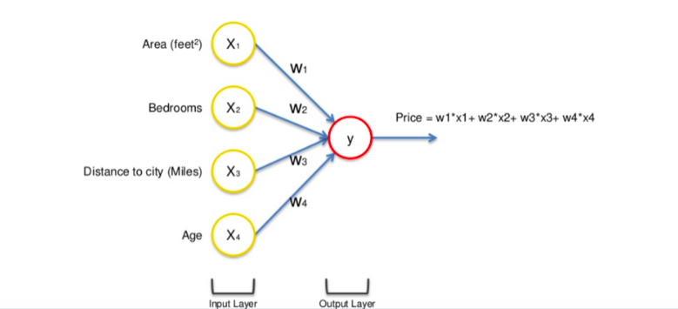
How does the Neural network work?
Let us take the example of the price of a property and to start with we have different factors assembled in a single row of data: Area, Bedrooms, Distance to city and Age.

Slide 47
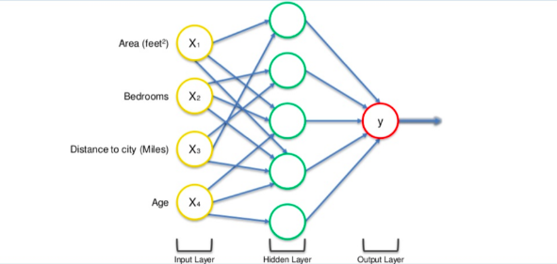
How does the Neural network work?
The input values go through the weighted synapses straight over to the output layer. All four will be analyzed, an activation function will be applied, and the results will be produced.
This is simple enough but there is a way to amplify the power of the Neural Network and increase its accuracy by the addition of a hidden layer that sits between the input and output layers.
A neural network with a hidden layer(only showing non-0 values)

Slide 48
How does the Neural network work?
Now in the above figure, all 4 variables are connected to neurons via a synapse. However, not all of the synapses are weighted. they will either have a 0 value or non-0 value.
here, the non-0 value → indicates the importance
0 value → They will be discarded.
You may wonder why that first neuron is only considering two of the four variables. In this case, it is common on the property market that larger homes become cheaper the further they are from the city. That’s a basic fact. So what this neuron may be doing is looking specifically for properties that are large but are not so far from the city.
Let's take the example of Area and Distance to City are non-zero for the first neuron, which means they are weighted and matter to the first neuron. The other two variables, Bedrooms and Age aren’t weighted and so are not considered by the first neuron.

Slide 49
How does the Neural network work?
Now, this is where the power of neural networks comes from. There are many of these neurons, each doing similar calculations with different combinations of these variables.
Once this criterion has been met, the neuron applies the activation function and do its calculations. The next neuron down may have weighted synapses of Distance to the city and, Bedrooms.
This way the neurons work and interact in a very flexible way allowing it to look for specific things and therefore make a comprehensive search for whatever it is trained for.

Slide 50
How do Neural networks learn?
Looking at an analogy may be useful in understanding the mechanisms of a neural network.
Learning in a neural network is closely related to how we learn in our regular lives and activities — we perform an action and are either accepted or corrected by a trainer or coach to understand how to get better at a certain task.
Similarly, neural networks require a trainer in order to describe what should have been produced as a response to the input. Based on the difference between the actual value and the predicted value, an error value also called Cost Function is computed and sent back through the system.
Cost Function: One half of the squared difference between actual and output value.

Slide 51
How do Neural networks learn?
For each layer of the network, the cost function is analyzed and used to adjust the threshold and weights for the next input. Our aim is to minimize the cost function. The lower the cost function, the closer the actual value to the predicted value. In this way, the error keeps becoming marginally lesser in each run as the network learns how to analyze values.
We feed the resulting data back through the entire neural network. The weighted synapses connecting input variables to the neuron are the only thing we have control over.

Slide 52
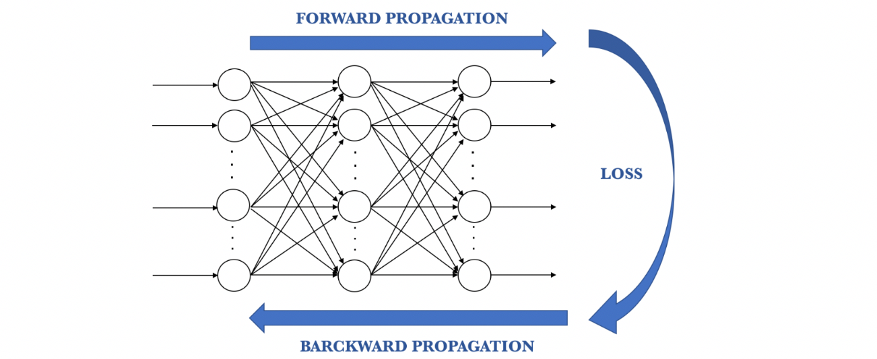
How do Neural networks learn?
As long as there exists a disparity between the actual value and the predicted value, we need to adjust those weights. Once we tweak them a little and run the neural network again, A new Cost function will be produced, hopefully, smaller than the last.
We need to repeat this process until we scrub the cost function down to as small as possible.

Slide 53
How do Neural networks learn?
The procedure described above is known as Back-propagation and is applied continuously through a network until the error value is kept at a minimum.
Back-propagation

Slide 54
How do Neural networks learn?
There are basically 2 ways to adjust weights: — 1. Brute-force method 2. Batch-Gradient Descent

Slide 55
Brute-force method
Best suited for the single-layer feed-forward network. Here you take a number of possible weights. In this method, we want to eliminate all the other weights except the one right at the bottom of the U-shaped curve.
Optimal weight can be found using simple elimination techniques. This process of elimination work if you have one weight to optimize. What if you have complex NN with many numbers of weights, then this method fails because of the Curse of Dimensionality.
The alternative approach that we have is called Batch Gradient Descent.

Slide 56
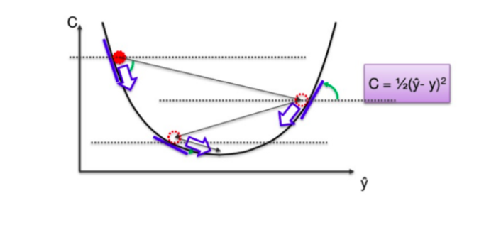
Batch-Gradient Descent
It is a first-order iterative optimization algorithm and its responsibility is to find the minimum cost value(loss) in the process of training the model with different weights or updating weights.
Gradient Descent

Slide 57
How do Neural networks learn?
In Gradient Descent, instead of going through every weight one at a time, and ticking every wrong weight off as you go, we instead look at the angle of the function line.
If slope → Negative, that means you go down the curve. If slope → Positive, Do nothing
This way a vast number of incorrect weights are eliminated. For instance, if we have 3 million samples, we have to loop through 3 million times. So basically you need to calculate each cost 3 million times.

Slide 58
How do Neural networks learn?
Stochastic Gradient Descent(SGD)
Gradient Descent works fine when we have a convex curve just like in the above figure. But if we don't have a convex curve, Gradient Descent fails.
The word ‘stochastic‘ means a system or a process that is linked with a random probability. Hence, in Stochastic Gradient Descent, a few samples are selected randomly instead of the whole data set for each iteration.

Slide 59
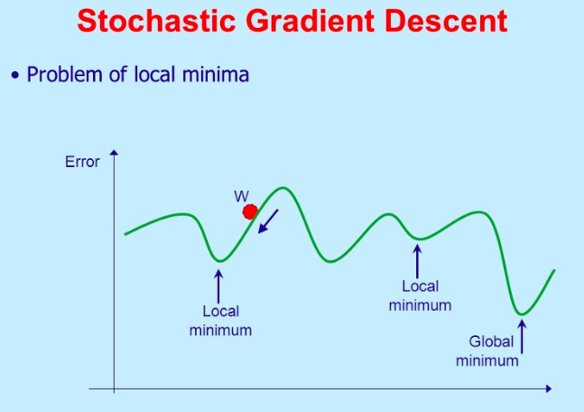
Stochastic Gradient Descent

Slide 60
How do Neural networks learn?
In SGD, we take one row of data at a time, run it through the neural network then adjust the weights. For the second row, we run it, then compare the Cost function and then again adjusting weights. And so on…
SGD helps us to avoid the problem of local minima. It is much faster than Gradient Descent because it is running each row at a time and it doesn’t have to load the whole data in memory for doing computation.

Slide 61
One thing to be noted is that, as SGD is generally noisier than typical Gradient Descent, it usually took a higher number of iterations to reach the minima, because of its randomness in its descent.
Even though it requires a higher number of iterations to reach the minima than typical Gradient Descent, it is still computationally much less expensive than typical Gradient Descent. Hence, in most scenarios, SGD is preferred over Batch Gradient Descent for optimizing a learning algorithm.

Slide 62
Training ANN with Stochastic Gradient Descent
Step-1 → Randomly initialize the weights to small numbers close to 0 but not 0.
Step-2 → Input the first observation of your dataset in the input layer, each feature in one node.
Step-3 → Forward-Propagation: From left to right, the neurons are activated in a way that the impact of each neuron's activation is limited by the weights. Propagate the activations until getting the predicted value.

Slide 63
Training ANN with Stochastic Gradient Descent
Step-4 → Compare the predicted result to the actual result and measure the generated error(Cost function).
Step-5 → Back-Propagation: from right to left, the error is back propagated. Update the weights according to how much they are responsible for the error. The learning rate decides how much we update weights.
Step-6 → Repeat step-1 to 5 and update the weights after each observation(Reinforcement Learning)
Step-7 → When the whole training set passed through the ANN, that makes and epoch. Redo more epochs.

Slide 64
GRADIENT DESCENT
Gradient descent is an optimization algorithm that's used when training a machine learning model.
It's based on a convex function and tweaks its parameters iteratively to minimize a given function to its local minimum.
WHAT IS GRADIENT DESCENT?
Gradient Descent is an optimization algorithm for finding a local minimum of a differentiable function.
Gradient descent is simply used to find the values of a function's parameters (coefficients) that minimize a cost function as far as possible.
"A gradient measures how much the output of a function changes if you change the inputs a little bit." — Lex Fridman (MIT)

Slide 65
DELTA RULE:
In machine learning, the delta rule is a gradient descent learning rule for updating the weights of the inputs to artificial neurons in a single-layer neural network.
It is a special case of the more general backpropagation algorithm.
The delta rule is derived by attempting to minimize the error in the output of the neural network through gradient descent.
The Delta rule in machine learning and neural network environments is a specific type of backpropagation that helps to refine connectionist ML/AI networks, making connections between inputs and outputs with layers of artificial neurons.
The Delta rule is also known as the Delta learning rule.

Slide 66
Limitations of Perceptrons
Perceptrons have a monotinicity property: - If a link has positive weight, activation can only increase as the corresponding input value increase (irrespective of other input values)
Can't represent functions where input interactions can cancel one another's effect (e.g. XOR)
Can represent only linearly separable functions.
Solution : multiple layers

Slide 67
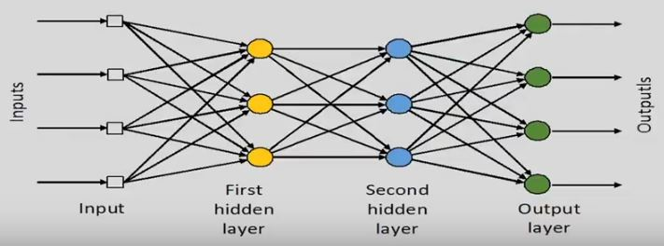
Multilayer Networks:
Multilayer networks solve the classification problem for non linear sets by employing hidden layers, whose neurons are not directly connected to the output.
Examples of Multilayer Neural Network Architectures.

Slide 68
Derivation of Backpropagation Algorithm

